Slide 1
DATA ANALYSIS AND OPTIMIZATION OF
SUPPLY CHAIN OF BAKERY BUSINESS
BDM CAPSTONE PROJECT
Name-Supravat Bar
Roll No-21f1004015
Email-21f1004015@ds.study.iitm.ac.in

Slide 2




CONTENTS
3.Data
Contents
Executive summary:
Introduction of the Business
Data collection and cleaning :All the preprocessing
Analysis : Analysis done in respect to the challenges
Findings : Important Insights about business
Recommendations: Solutions/Recommendations for business
01
02
03
04
05

Slide 3
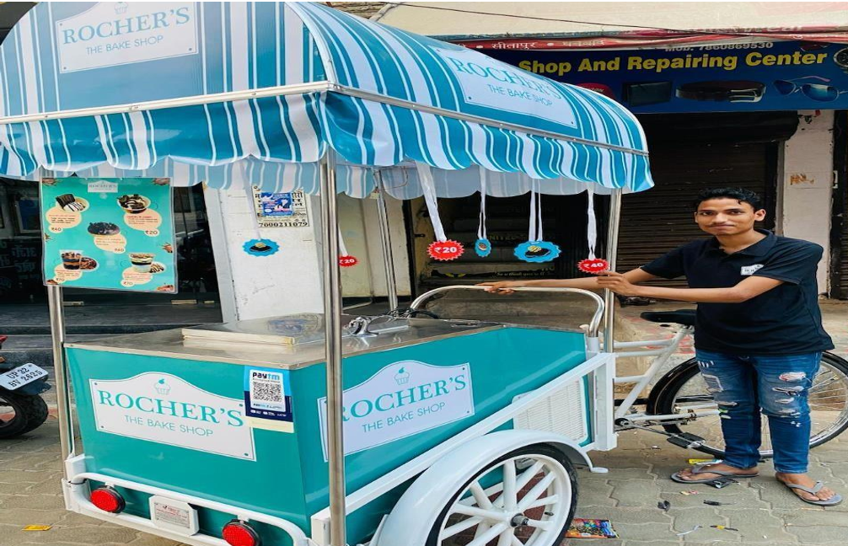
EXECUTIVE SUMMARY
Rocher's The Bake Shop, a cloud kitchen based bakery, thrived with its innovative use of
mobile carts offering high-quality baked goods at affordable prices
in Lucknow city. They have started in early 2021.
Challenges:
Market Competition: Increased competition from other online and physical bakeries has impacted revenue.
Weather Conditions: The reliance on cart sales exposes the business to weather-related disruptions, affecting sales consistency.
Inventory Limitations: The small size of the carts limits the volume and variety of products that can be offered, leading to potential stock shortages and missed sales opportunities.
Home delivery constraints: The cart based model limits the ability to fulfil home delivery requests, further constraining market reach.

Slide 4


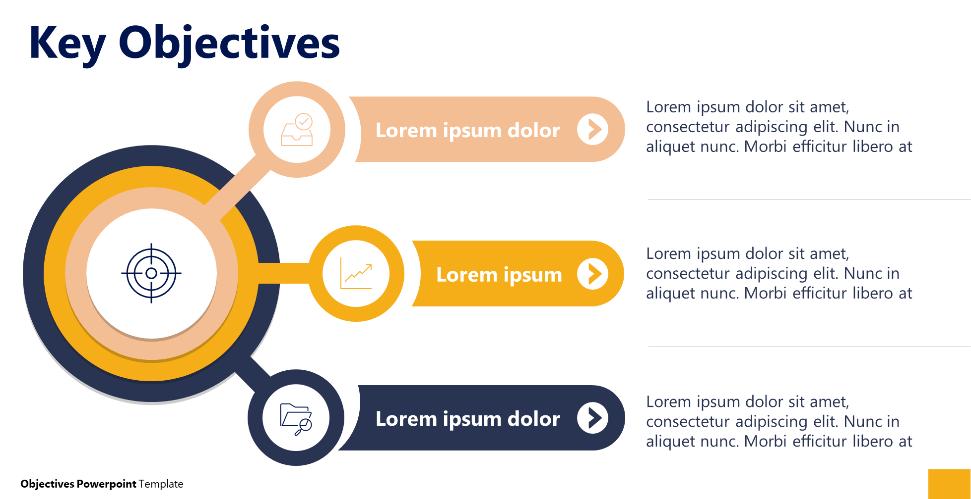
Data Collection & cleaning:
I have collated 5 months of data from 1st Nov 23 to 31st March 24 which includes the sales
of 10 different products every day.
Data collection
Raw data is further cleaned for analysis.
Data cleaning
Hence to Consolidated and clean the data Google Sheets/Excel was used for data cleaning and future analysis.
Data analysis

Slide 5
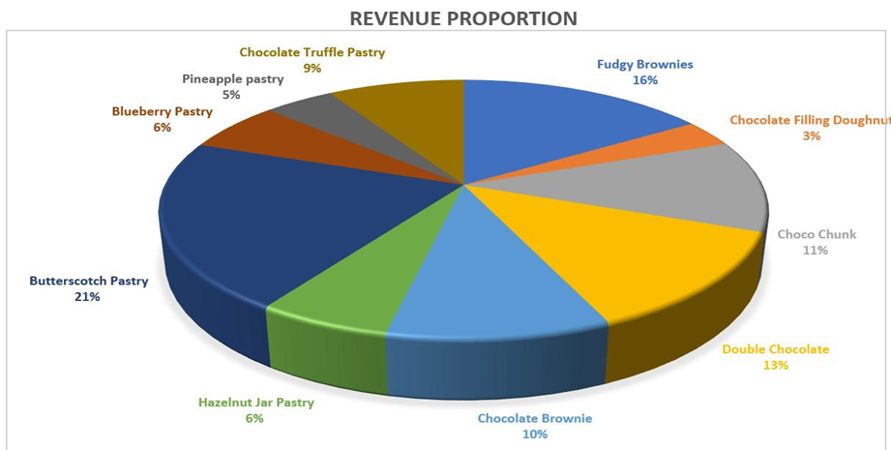
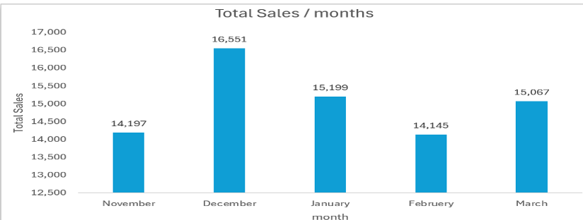
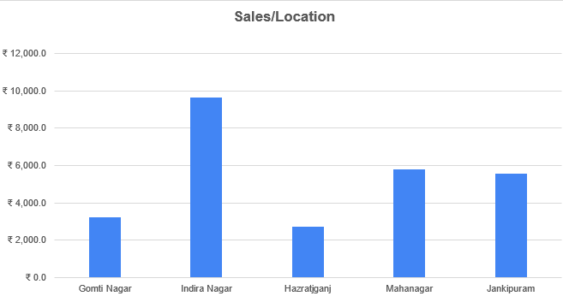
Data Analysis:
Objective 1: Sales
1. They have approximately 8 Lacks of sales per month including net profit of 70 thousand after deducting all other expenses.
2. Butterscotch Pastry takes 21% for the revenue pie
Chart with total revenue of ₹1,15,935.0
3.The sales trends shows the sales are approx15% high in December month. Compare to its previous months due to festive season.
4. The sales per location shows the sales is much higher in Indira Nagar compare to other places in Lucknow.

Slide 6
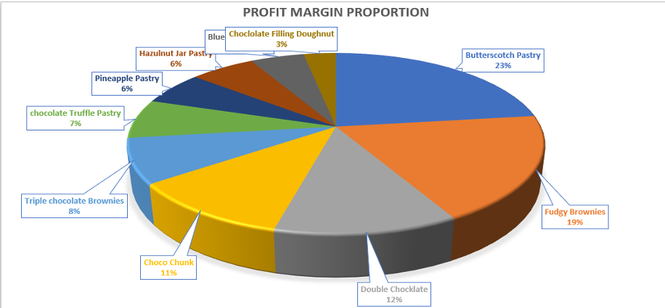
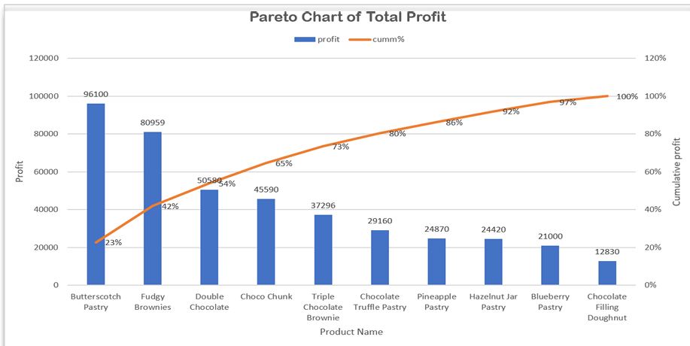
Data Analysis:
Objective 2: Cost Management
Profit Margin: Maintained at 25-40% across all products.
Refrigeration Impact:
Reduced spoilage by 15%, extending shelf life by 2 days.
Promotions Effect:
Improved sales efficiency, contributing 20% to monthly revenue.
Top Product:
Butterscotch Pastry is the most profitable, accounting for 23% of total profit.
Profit Distribution:
54% of total profit comes from three key products—Butterscotch Pastry, Fudgy Brownies, and Double Chocolate Brownies.
Strategic Focus:
Emphasize high-performing products while optimizing the performance of others to ensure balanced growth and higher profitability.

Slide 7
Results & Findings
Revenue Contribution
Seasonal Trends
Geographical Insights
Inventory Insights
Profitability
Butterscotch Pastry highest at 21%.followed by fudgy brownies and double chocolate contribution total
54%.
December sales increased by 12% due to festivals. In holidays also there is a sales increase.
Indira Nagar & Maha Nagar account for 57% of sales which are residential and commercial zone.
High wastage for low-demand items (Jar Cakes - 10%).
Contributing only 21000 monthly.
Monthly net profit ~₹72,000 maintain after deducting all the necessary cost.
1
2
3
4
5

Slide 8
Recommendation
Data-driven insights help optimize revenue and operational efficiency.
Focus on top-performing products and high-footfall areas.
Implement targeted marketing for promotions and bundling.
Improve inventory planning to minimize wastage.
Strategic expansion and operational improvements ensure long-term growth
Improve demand forecasting and stock rotation to minimize wastage, especially for low-turnover items like pineapple pastries.
Focus on High-Revenue Products
Prioritize production like Butterscotch pastry, fudgy brownies and marketing efforts for the top 4 products that contribute 61% of revenue and 54% of profit.
Leverage seasonal trends
Optimize Inventory Management
Enhance Refrigeration Efficiency
Increase promotional activities during peak seasons like December to sustain and maximize the 12% sales boost
Continue investing in refrigeration solutions to further reduce spoilage beyond the current 15% improvement.

Slide 9
Recommendation
Expand to High-Potential Areas
Strengthen Promotional Strategies
Reduce Wastage Costs
Optimize Operational Workflow
Implement better tracking systems and portion control to lower wastage by 10%, translating into ₹4,000-5,000 in monthly savings.
Streamline supply chain processes to improve efficiency, minimize losses, and enhance overall profitability.
Introduce new mobile carts in Indira Nagar and Maha Nagar to tap into a broader residential customer base.
Implement targeted marketing campaigns to boost holiday sales, potentially increasing revenue by an additional ₹96,000.

Slide 10

Thank You.

